Slide 1
Release process

Slide 2
Three Platforms
"Trydev" http://trydev.activeeon.com Updated every morning with a nightly build (snapshot)
"TryQA" http://tryqa.activeeon.com Updated every thursday with a weekly build (RC)
"Try" http://try.activeeon.com Updated on demand with a public release (generated from an RC build)

Slide 3





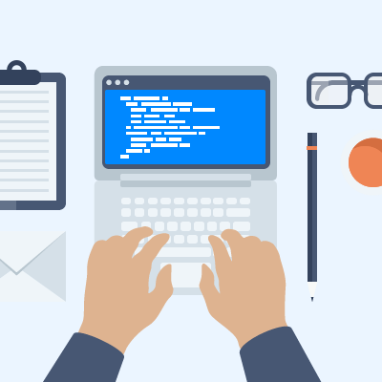

Pull Request
Local tests
PR
CI Tests
Peer Review
Merge
7.20.0-rc.1
7.20.0-rc.2
7.20.0-rc.3
7.20.0-rc.4
7.21.0-rc.1
a978026
b528041
0c671ba
dddd
bc50a1d
c6883ef
master
thursday
cherry-pick
build
7.20.0
7.20.1
tag
0c671ba
f07b25c
branch
tuesday
7.20.X
Nightly Release
7.20.0-20161121-0511-SNAPSHOT
Every morning at 5am (triggered automatically)
Deploy on trydev
Publish documentation: /dev (alias) /7.20.0-20161121-0511-SNAPSHOT
System Tests
Weekly Release (RC)
7.20.0-rc.2
Every thursday (triggered manually)
Deploy on tryqa
Upload on S3 (60 days retention policy)
Publish documentation: /rc (alias) /7.20.0-rc.2
Release (on demand)
7.20.0
Triggered manually
Deploy on try
Upload on S3
Publish documentation: /latest (alias) /7.20.0

Slide 4
Reminder of objectives:
- We build an 7.XY-RCz (let say on Thursday) that is put on TryQA
- We test it and validate it.
- No code freeze more than 2 or 3 hours.
- On Tuesday:
o We decide that 7.XY-RCz is good, and it becomes 7.XY (Public Release)
[Main Branch becomes 7.XY+1] [7.XY put on Try.]
o We decide that 7.XY-RCz is almost good, and we produce 7.XY, and right away 7.XY.1 (Public Release)
[Main Branch becomes 7.XY+1] [7.XY.1 put on Try.]
o We decide that 7.XY-RCz is not good or not interesting to use it as Public Release:
we just drop it (it will be a Private Release), and we will generate later on 7.XY-RCz+1

Slide 5
Weekly Release Steps
https://docs.google.com/drawings/d/1AeqduRRPZiuy4p4x_eIERD2sa4ifapo_tSrDPu5FVG0/edit

